Slide 1
Niños retornando de Estados unidos a méxico
Coloquio La Frontera Noreste de México: migración y desarrollo. Monterrey, N. L. 24 y 25 de septiembre 2015. El Colegio de la Frontera Norte
Víctor Zúñiga, Tecnologico de Monterrey, doctorado en ciencias sociales

Slide 2
introduction
Purposes:
  To present the main quantitative findings drawn from four surveys we conducted in Nuevo León (2004/2005), Zacatecas (2005/2006), Puebla (2009/2010), Jalisco (2010/2011).

Slide 3
introduction
Binational (U.S./Mexico team), interdisciplinary working in return migration from the U.S. to Mex:
  Edmund T. Hamann, UNL, anthropology/education
  Juan Sánchez, IIIEPE-Nuevo León, education
  Rubén Hernández-León, UCLA, sociology
  Shinji Hirai, CIESAS-Noreste, anthropology
  William England, UNL, education/geography
  Anabela Sánchez, UDEM, sociology
  Mariana Gabarrot, Monterrey-Tec, geography
  Catalina Panait, Monterrey-Tec, linguistics
  Betsabé Román, education
  Jennifer Stacy, UNL, education
  José Juan Olvera, CIESAS-Noreste, sociology
  Víctor Zúñiga, UDEM, sociology

Slide 4
introduction
Our research journey:
  1997-2004: Georgia (Dalton city, and Whitfield, Murray, Chattooga, Calhoun, and Tifton counties).
  2004-2005: Nuevo León.
  2005:-2006: Zacatecas.
  2009:-2010: Puebla
  2010-2011: Jalisco
  2013-2016: Morelos

Slide 5
Sources of data
In 1997, conducting fieldwork in Dalton and Whitfield County, Georgia, we heard from local principals and teachers that Latino students sometimes “disappeared” from the schools (Hamann, 2003; Hernández-León and Zúñiga, 2000; Zúñiga and Hernández-León, 2009).
The “disappearances” led one of us (Hamann, 2001) to develop a concept—the sojourner student (which resisted the either/or nature of the sojourner vs. settler debate)—and draw from it various pedagogical/political conclusions.

Slide 6
Sources of data

Slide 7
Quantitative results: estimations from the samples
Categories | N.L 2004 | N. L. % | Zac 2005 | Zac % | Puebla 2009 | Pue% | Jalisco 2010 | Jal %
returnees | 11,000 | 2.5 | 4,000 | 3.3 | 4,000 | 1.2 | 30,000 | 4.7
International migrants | 6,000 |  | 5,000 |  | 8,000 |  | 34,000
Children left behind (*) | 32,000 | 4.5 | 43,000 | 15.3 | 85,000 | 8.8 | 58,000 | 4.3
No links with migration to the U.S. | 655,000 | 93.0 | 230,000 | 81.4 | 869,000 | 90.0 | 1,226,000 | 91
Total enrolment | 704,000 | 100 | 282,000 | 100 | 966,000 | 100 | 1,348,000 | 100

Slide 8
Where are children coming from?
Notes:
We should say ‘25 other States. (Students from 39 of 50 states.) Given that U.S. states that transnational students have lived in varied a lot by receiving state, we don’t know how representative these percentages are of the U.S. school experience sites of Mexico’s transnational population. Given slide #9, the ‘do not remember population seems incorrect. Was it 14% (instead of 4%)?

Slide 9
Where are children coming from?

Slide 10
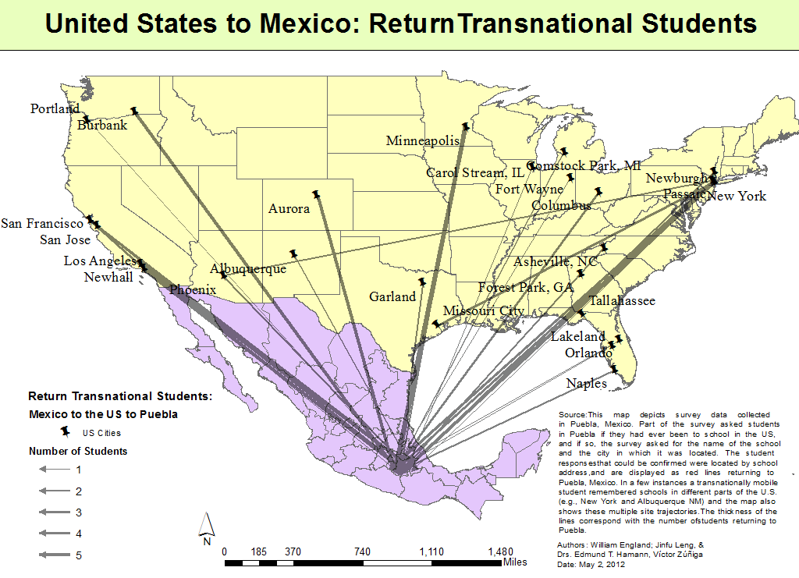
Returning geographies: The case of Puebla

Slide 11
Students’ Exposition to international migration (four samples)
Types of migrant children | Definition | Results from our surveys | National estimations
Returnees | Born in Mexico, a period in the U.S., then return | 1.3% | 260,000
International migrants (dual nationality) | Born in the U.S. and living in Mexico | 1.6% | 320,000
Children left behind | Born in Mexico, but their father and/or mother are in the U.S. as of the day of the survey | 7.8% | 1,560,000
Total |  | 10.7% | 2,140,000

Slide 12
Family separation
 | MIGRANTS (returnees and international migrants) |  |  |  | NON MIGRANTS
 | Separated from their mothers |  | Separated from their fathers |  | Separated from their mothers |  | Separated from their fathers
STATES | yes | no | yes | no | yes | no | yes | no
NL (2004) | 7.5% | 91.7% | 19.0% | 81.0% | 0.5% | 99.5% | 4.1% | 95.9%
ZAC (2005) | 4.3% | 95.7% | 30.1% | 69.9% | 1.4% | 98.6% | 15.3% | 84.7%
PUE (2009) | 9.9% | 90.1% | 30.3% | 69.7% | 2.0% | 98.0% | 8.1% | 91.9%
JAL (2010) | 4.0% | 96.0% | 19.3% | 80.7% | 0.6% | 99.4% | 4.6% | 95.4%

